Slide 1
What Could Go Wrong?
The Simple Question Your Students Can Build a Story Around
Download
handouts
and slides at robinpawlak.com
Robin Pawlak

Slide 2
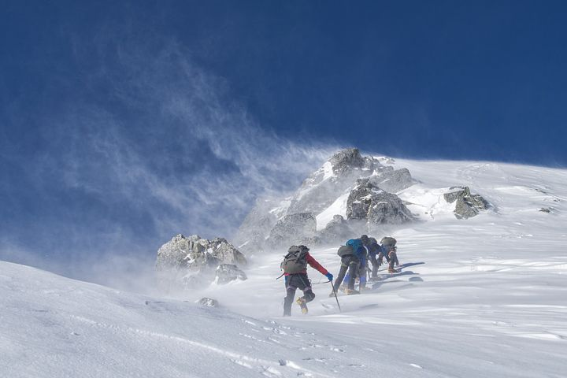
“I don’t know what to write!”

Slide 3
“I don’t know what to write!”

Slide 4
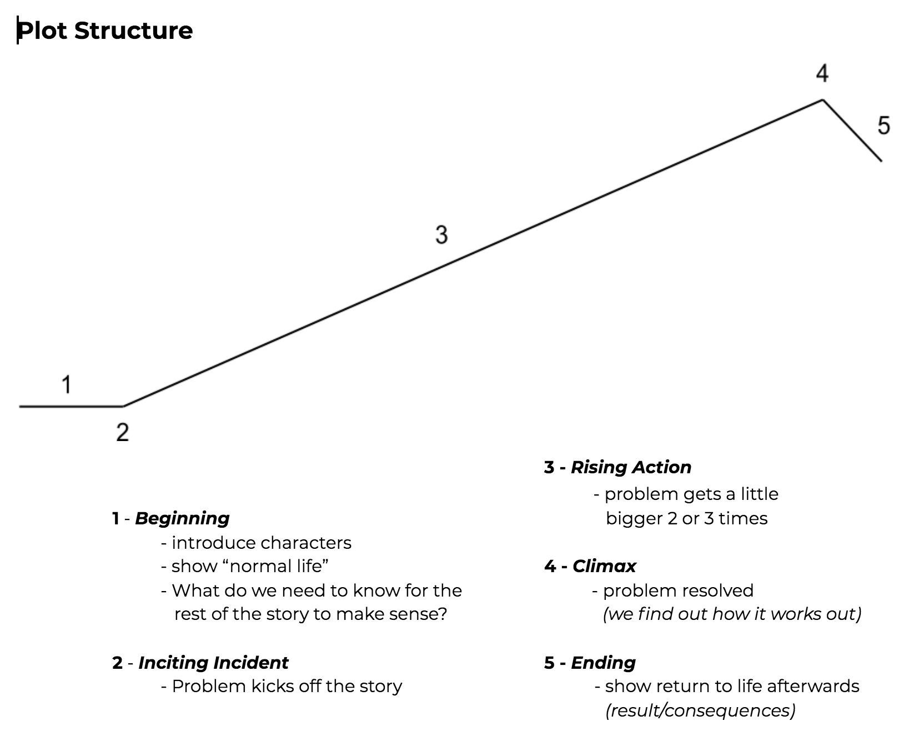
Plot Structure

Slide 5
Step 1A
Students brainstorm simple, everyday activities, such as . . .

Slide 6
Step 1B
Students choose 1 option to develop.

Slide 7
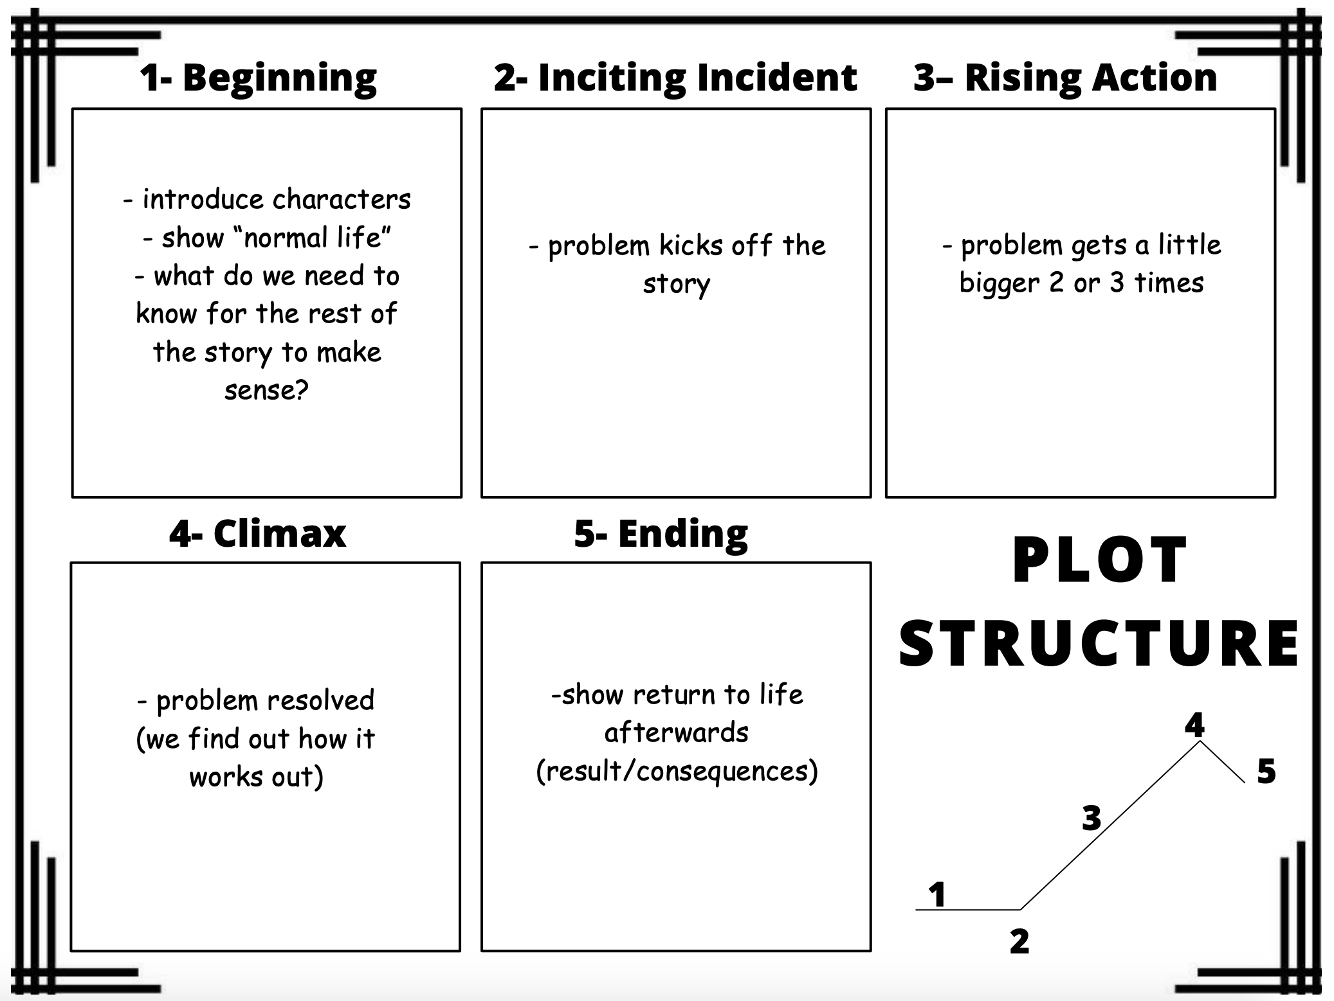
Step 1C
Students record their choice.

Slide 8
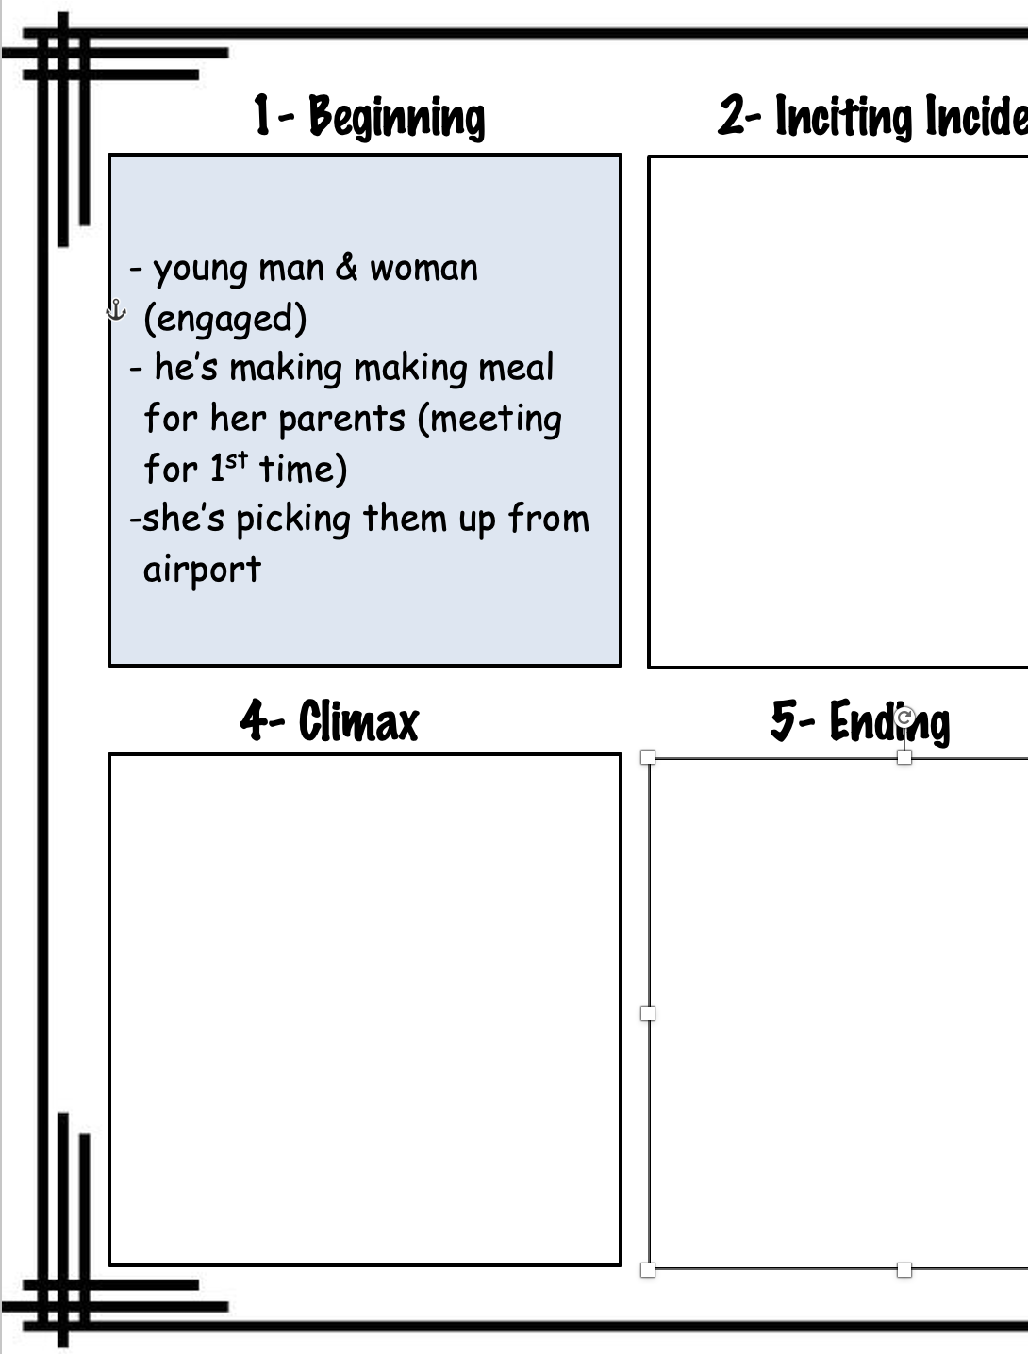

Slide 9
Plot Structure
YOU ARE HERE

Slide 10
Step 2
2nd round of brainstorming:
Students create their inciting incident by asking the question, What could go wrong?

Slide 11
Example:
Making a meal
What Could
Go Wrong?

Slide 12
Step 3
Students develop 1 idea.
Make the problem bigger
Foolish decisions
Added challenges
Failed attempts to solve problem
Conflicts between characters
Increase consequences

Slide 13
Example:
Making a meal
How can we make the problem bigger?

Slide 14
Example:
Foolish decisions
Added challenges
Failed attempts to solve problem
Conflicts between characters
Increase consequences
Making a meal
How can we make the problem bigger?

Slide 15
Plot Structure
OKAY,
NOW YOU’RE HERE

Slide 16
Students Record
2 or 3 times

Slide 17
Step 4
Students brainstorm ways
to resolve the problem.
Suggestions:
Success
Temporary success (new/repeat problem)
Fail/alternate approach
Fail/give up
Twist

Slide 18
Step 5
Students brainstorm endings.
5 - Ending

Slide 19
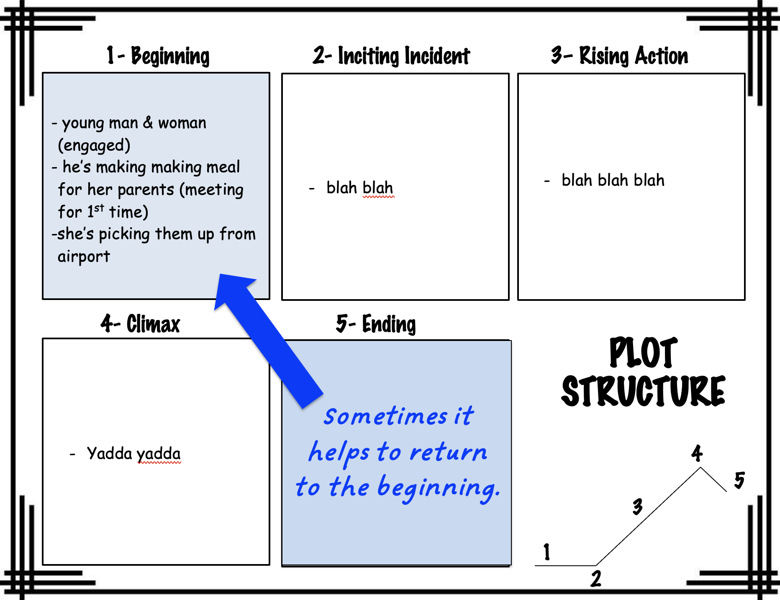
Step 5: Endings
How do things end up for the characters?
What does “ordinary life” look like for them now?

Slide 20
Step 6
Students write the story!

Slide 21
Where to Begin?
At the beginning?
Teach each part!

Slide 22
Idea #2: Box Story
A story is a character who
wants something and
overcomes conflict to get it.
— Donald Miller

Slide 23
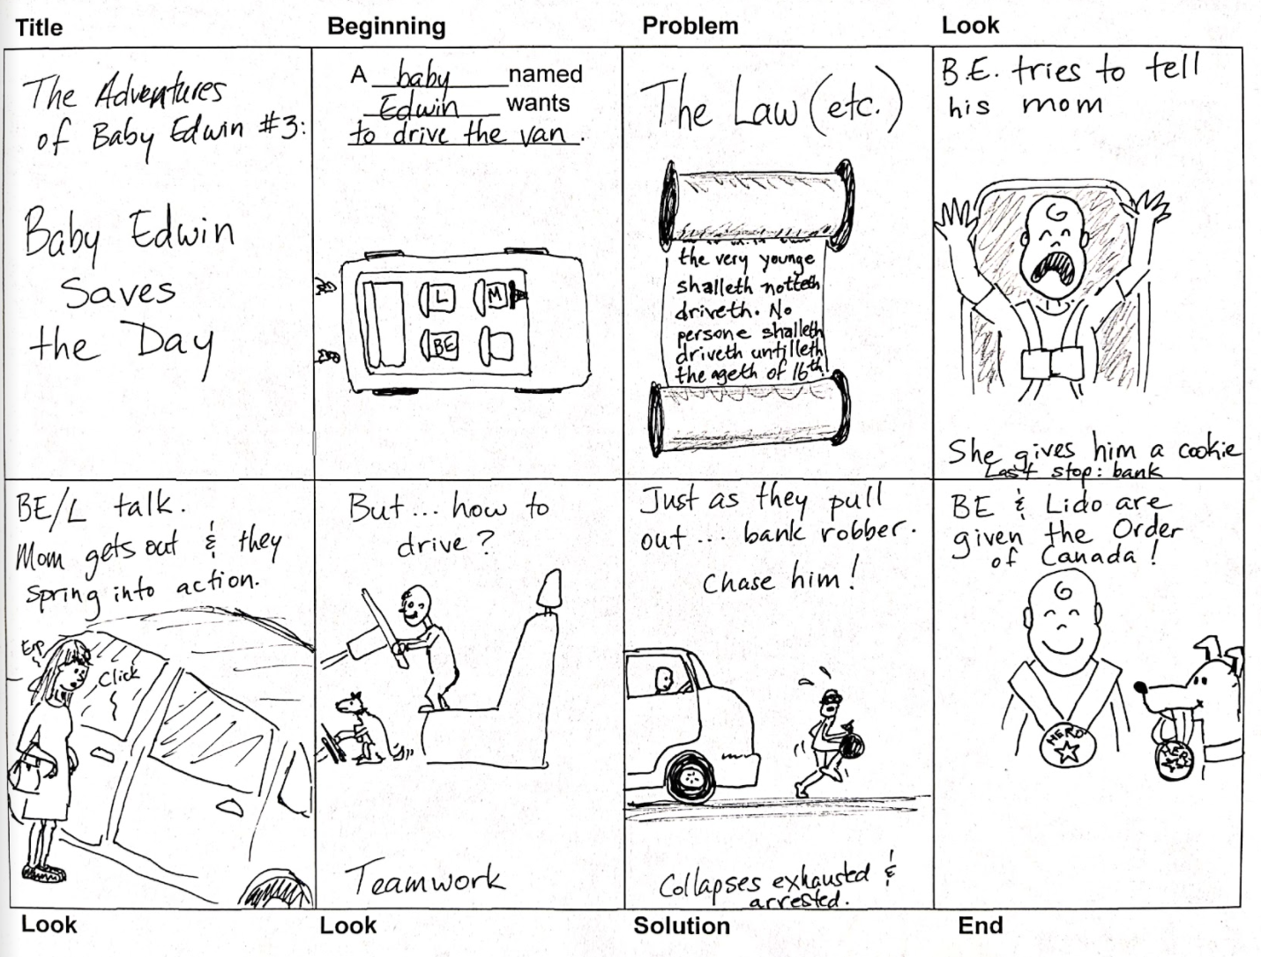

Slide 24
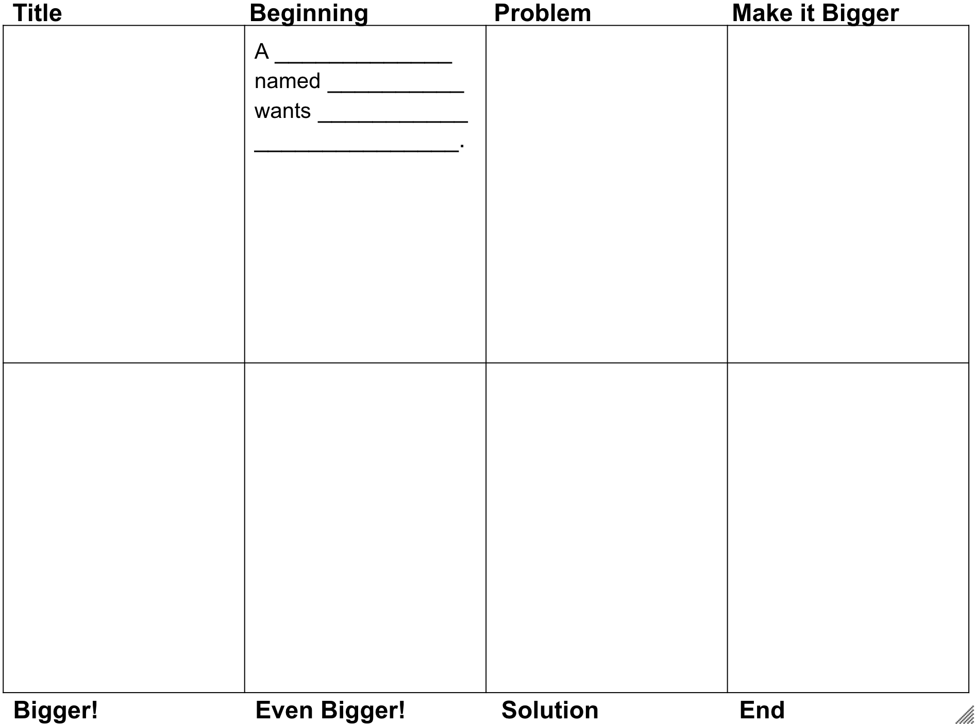

Slide 25
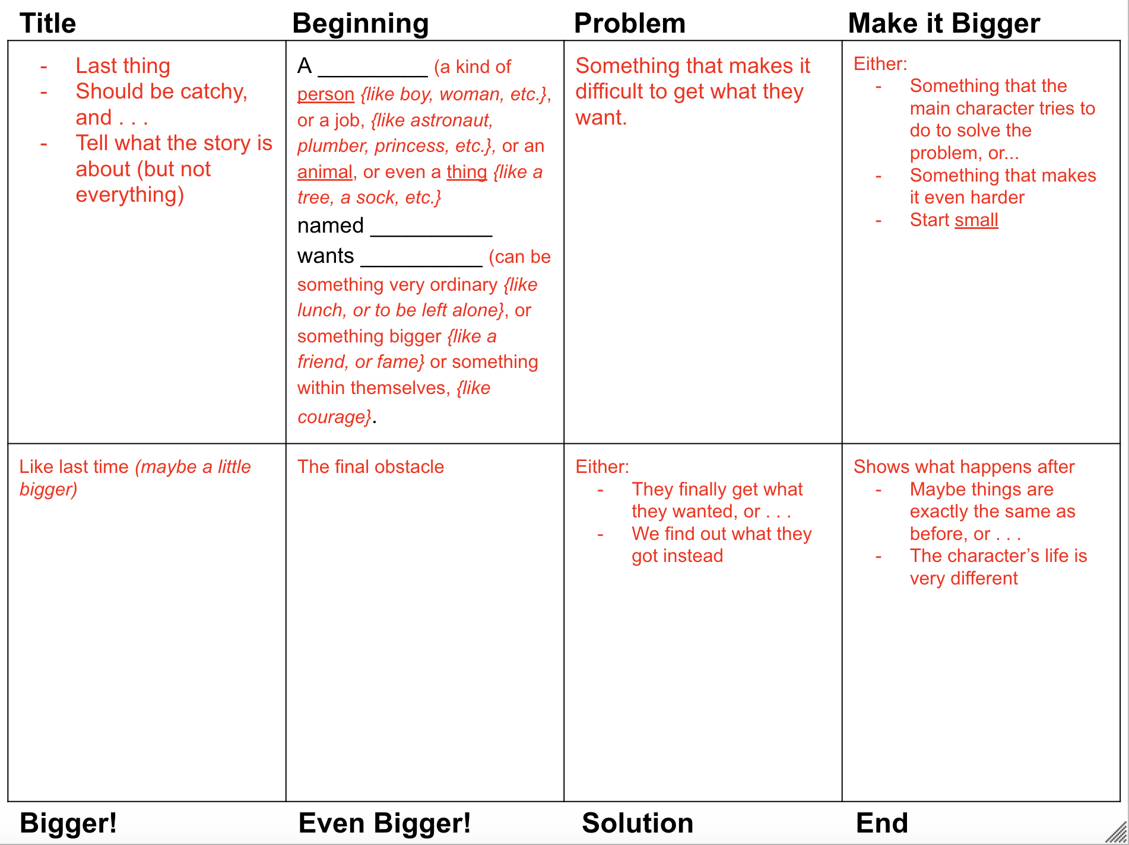

Slide 26
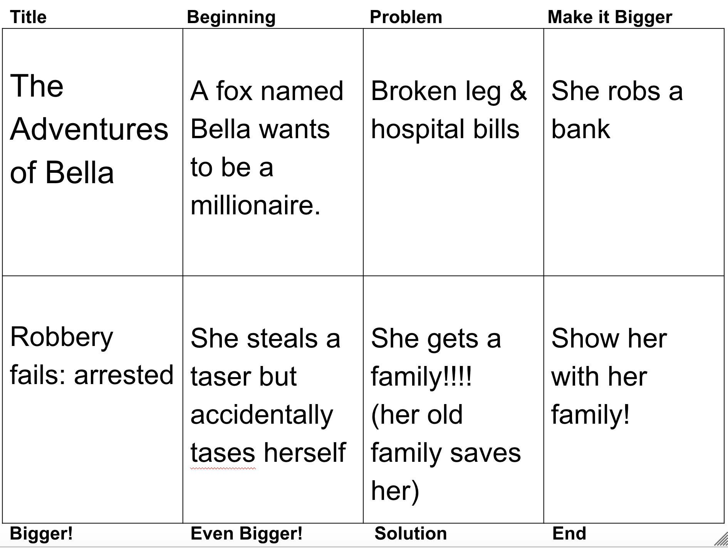

Slide 27
So . . . Anything else?
To what extent do you
feel equipped to implement these ideas in your classroom?
Is there anything you
wish we’d talked about
that we didn’t cover?
What ideas or resources have worked
well for you? (Please share!)

Slide 28
Connect with me at robinpawlak.com
Thanks!
Or . . .

