Slide 1
WRITING 101
Slides & resources available at
robinpawlak.com
Fun fact: The terms upper case and lower case originated back when typesetters kept each set of letters in a separate tray, with capital letters placed above the others.

Slide 2
The Plan
The Nature of Writing
The Nature of People
Implications for Learning & Teaching Writing
Examples & Ideas

Slide 3
Which of the following statements most resonates with you?
The Dichotomous Nature of Writing
Statement 1
Writing is . . .
Logical
Rational
Linear
Understandable via accepted conventions
Something you get better at by learning rules and acquiring skills

Slide 4
Which of the following statements most resonates with you?
The Dichotomous Nature of Writing
Statement 2
Writing is an inherently creative process by which thoughts, feelings and images are transferred from one person to another. Understood by the heart as much as the mind, it is highly intuitive and primarily navigated by feel.

Slide 5
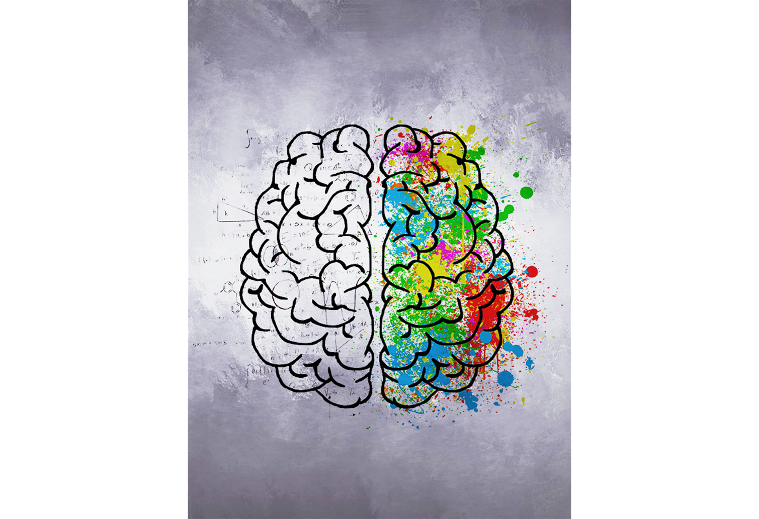
Left Brain & Right Brain
Logical
Rational
Linear
Conventions
Rules
Skills
Creative
Thoughts
Feelings
Images
Intuitive
By feel
Image by Léa Latulippe from Pixabay

Slide 6
Logical/Rational & Creative/Intuitive
Logical
Rational
Linear
Conventions
Rules
Skills
Creative
Thoughts
Feelings
Images
Intuitive
By feel
Image by Léa Latulippe from Pixabay

Slide 7
The Nature of Writing:

Slide 8
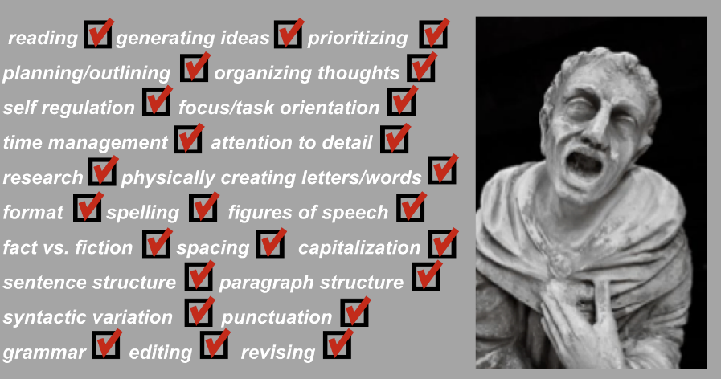
The Nature of Writing:

Slide 9
The Nature of Writing:

Slide 10
A Simple Formula:

Slide 11
Writing is not a particular thing,
or any single skill. In fact, the writing
process involves many, many steps and
requires virtually innumerable skills.
Writing instruction that fails to take this
into account invariably leads to untold
frustration for student and teacher alike.

Slide 12
The Plan…
It’s incredibly complex!
The Nature of Writing
The Nature of People
Implications for Learning & Teaching Writing
Examples & Ideas

Slide 13
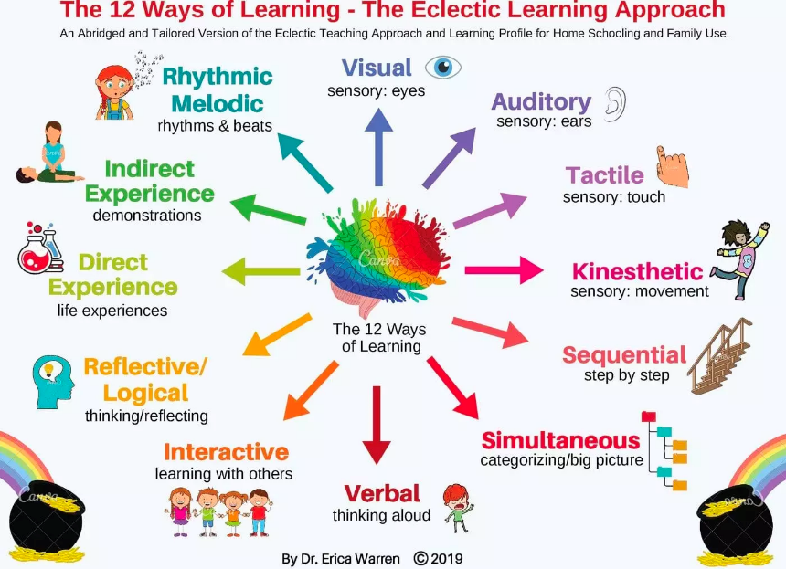
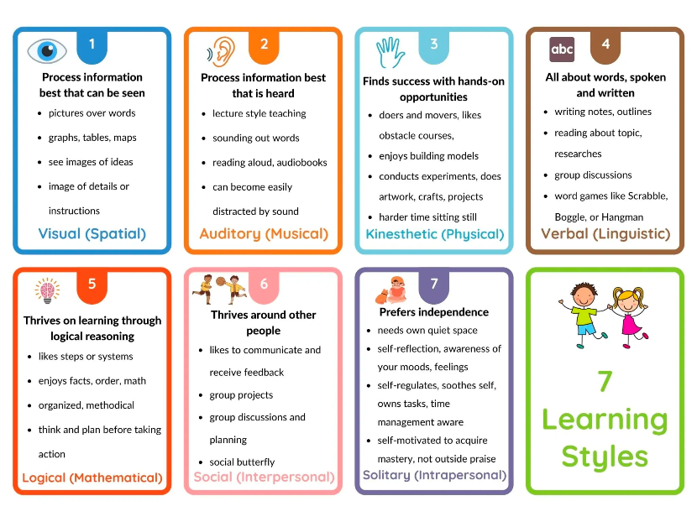
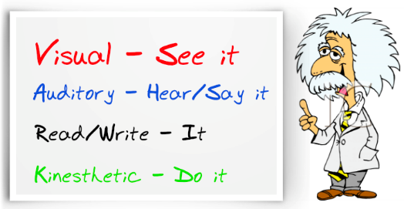
People Learn in Diverse Ways
Learning
Styles (etc.)

Slide 14
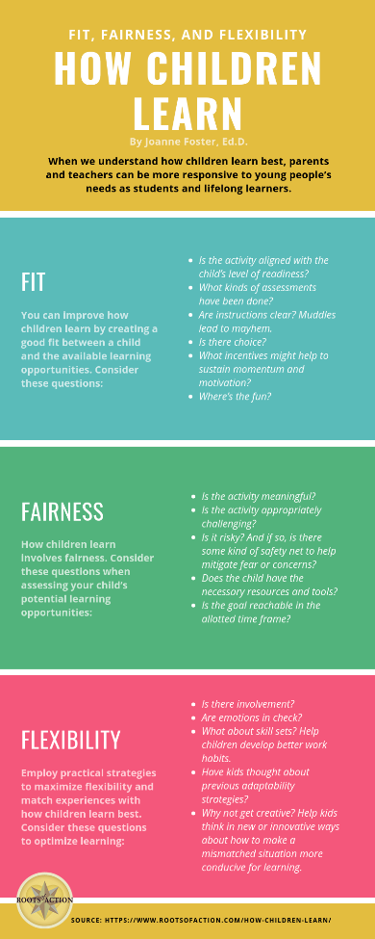
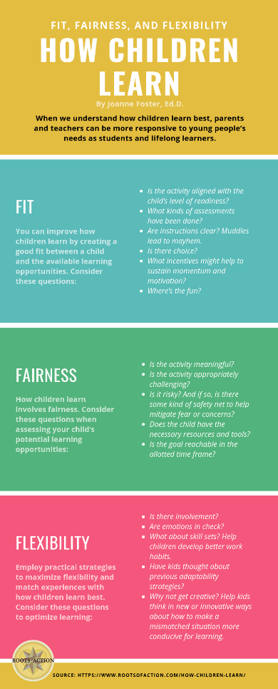
The Nature of People: Other Factors

Slide 15
The Nature of People: Other Factors

Slide 16
The Plan…
It’s incredibly complex!
The Nature of Writing
The Nature of People
Implications for Learning & Teaching Writing
Examples & Ideas
We think & learn
in diverse ways

Slide 17
Let’s talk about this . . .
It’s incredibly complex!
The Nature of Writing
The Nature of People
Implications for Learning & Teaching Writing
Examples & Ideas
We think & learn
in diverse ways
How does this
track with what you see
in your classroom?
Given what we’ve
discussed, what might be some effective ways to approach
writing instruction?

Slide 18
Implications for Teaching Writing
Due to the complexity of writing, instruction is most successful when we . . .
Break it down!
Student-driven
Because children think and learn in diverse ways, they benefit from writing instruction that is . . .

Slide 19
Break it Down
As much as possible teach and assess
one thing at a time.

Slide 20
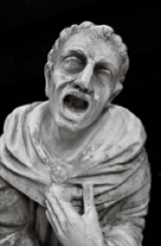
Writing is incredibly complex!

Slide 21
Break it Down
Requires analysis of every writing task:
What skills will they need?
Which ones matter?

Slide 22
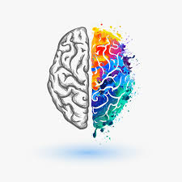
Student-Driven
Humans
think & learn
in diverse
ways
.

Slide 23
Student-Driven
They learn
what they learn
when they’re ready to learn it.

Slide 24
Student-Driven
How can we approach
writing instruction such that
all students are afforded
their best opportunity to be successful?

Slide 25
The Plan
The Nature of Writing ✔
The Nature of People ✔
Implications for Learning & Teaching Writing ✔
Examples & Ideas

Slide 26
But . . . how? Examples & Ideas
Break it Down
Teach & assess 1 thing at a time
What skills will they need? Which ones matter?
Student-Driven
They learn what they learn when they’re ready to learn it
We think & learn in different ways
Personal Narrative:
Formative
Assessment

Slide 27
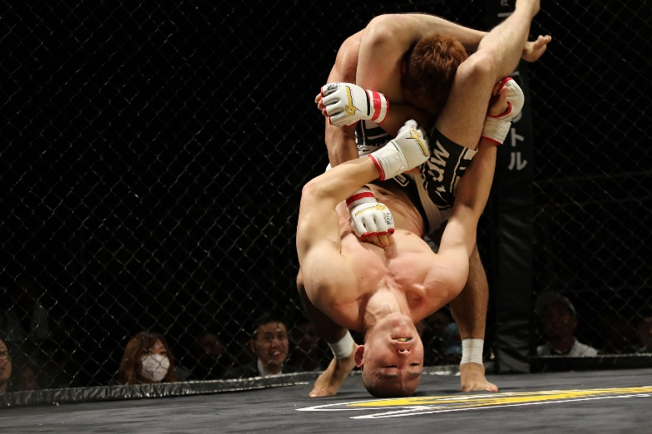
But . . . how? Examples & Ideas
Break it Down
Teach & assess 1 thing at a time
What skills will they need? Which ones matter?
Student-Driven
They learn what they learn when they’re ready to learn it
We think & learn in different ways
Social Studies:
Opinion
Paragraph
Image by Mirko Zax from Pixabay

Slide 28
But . . . how? Examples & Ideas
Break it Down
Teach & assess 1 thing at a time
What skills will they need? Which ones matter?
Student-Driven
They learn what they learn when they’re ready to learn it
We think & learn in different ways
Social Studies:
Opinion
Paragraph
Image by Mirko Zax from Pixabay

Slide 29
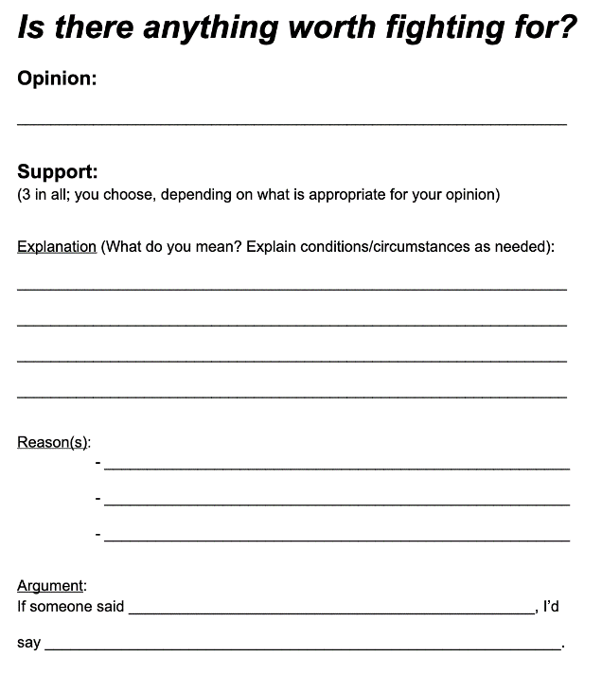
But . . . how? Examples & Ideas
Break it Down
Teach & assess 1 thing at a time
What skills will they need? Which ones matter?
Student-Driven
They learn what they learn when they’re ready to learn it
We think & learn in different ways
Social Studies:
Opinion
Paragraph

Slide 30
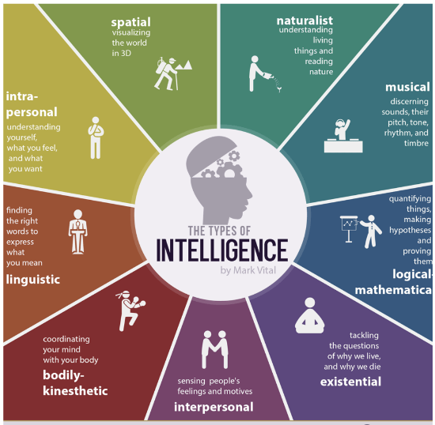
But . . . how? Examples & Ideas
Break it Down
Teach & assess 1 thing at a time
What skills will they need? Which ones matter?
Student-Driven
They learn what they learn when they’re ready to learn it
We think & learn in different ways
Creative Writing:
How to Get Your
Students Writing

Slide 31
But . . . how? Examples & Ideas
Creative Writing:
Break it Down
Teach & assess 1 thing at a time
What skills will they need? Which ones matter?
Student-Driven
They learn what they learn when they’re ready to learn it
We think & learn in different ways

Slide 32
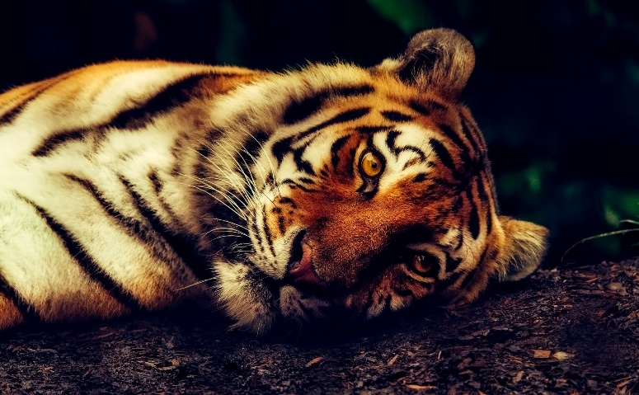
But . . . how? Examples & Ideas
Break it Down
Teach & assess 1 thing at a time
What skills will they need? Which ones matter?
Student-Driven
They learn what they learn when they’re ready to learn it
We think & learn in different ways
Science Report:
Animals
Image by David Mark from Pixabay

Slide 33
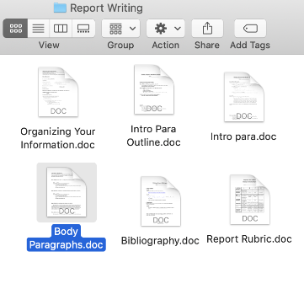
But . . . how? Examples & Ideas
Break it Down
Teach & assess 1 thing at a time
What skills will they need? Which ones matter?
Student-Driven
They learn what they learn when they’re ready to learn it
We think & learn in different ways
Science Report:
Animals
Image by David Mark from Pixabay

Slide 34
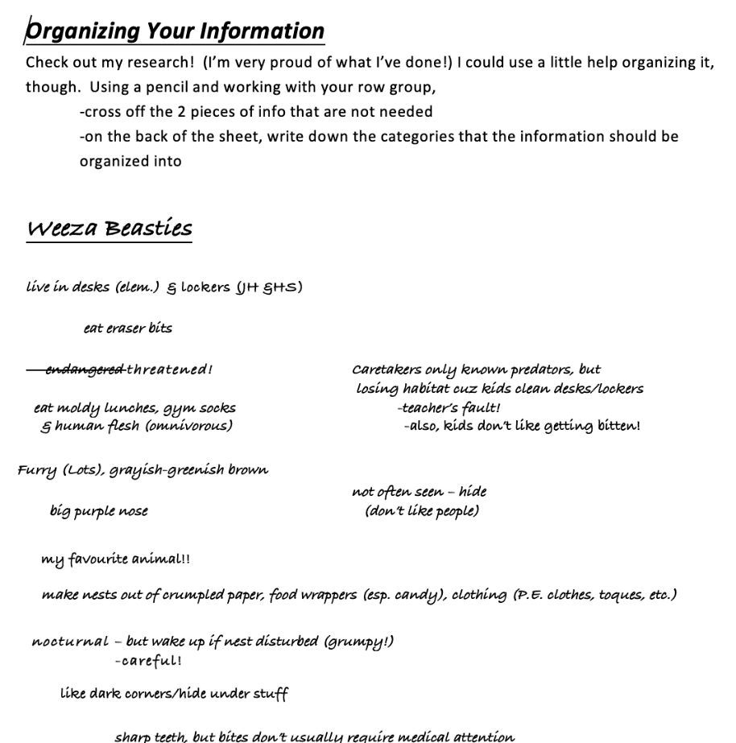
But . . . how? Examples & Ideas
Break it Down
Teach & assess 1 thing at a time
What skills will they need? Which ones matter?
Student-Driven
They learn what they learn when they’re ready to learn it
We think & learn in different ways
Science Report:
Animals
Image by David Mark from Pixabay

Slide 35
Anything Else?
Something
we missed?
Questions?
Ideas or resources
to share?

Slide 36
Implications for Teachers Improving their Practice
Break it down!
Student-driven
You’re the student!

Slide 37
Thanks!
Connect with me at
robinpawlak.com
OR . . .
We can also connect on Twitter (@1robinstweet)
or Facebook/Instagram (1robinpawlak)

