Slide 1
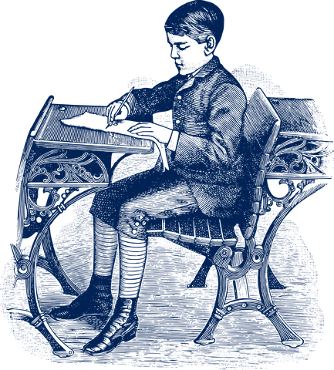
How to Get Your Students Writing
Slides & resources
available at
robinpawlak.com
Actual photo of Robin Pawlak, age 12
Courtesy National Museum of Antiquities
Notes:
https://robinpawlak.com/

Slide 2
The Foundation (1)
Teach Basic Plot Structure
Notes:
https://robinpawlak.com/teacher-resources/

Slide 3
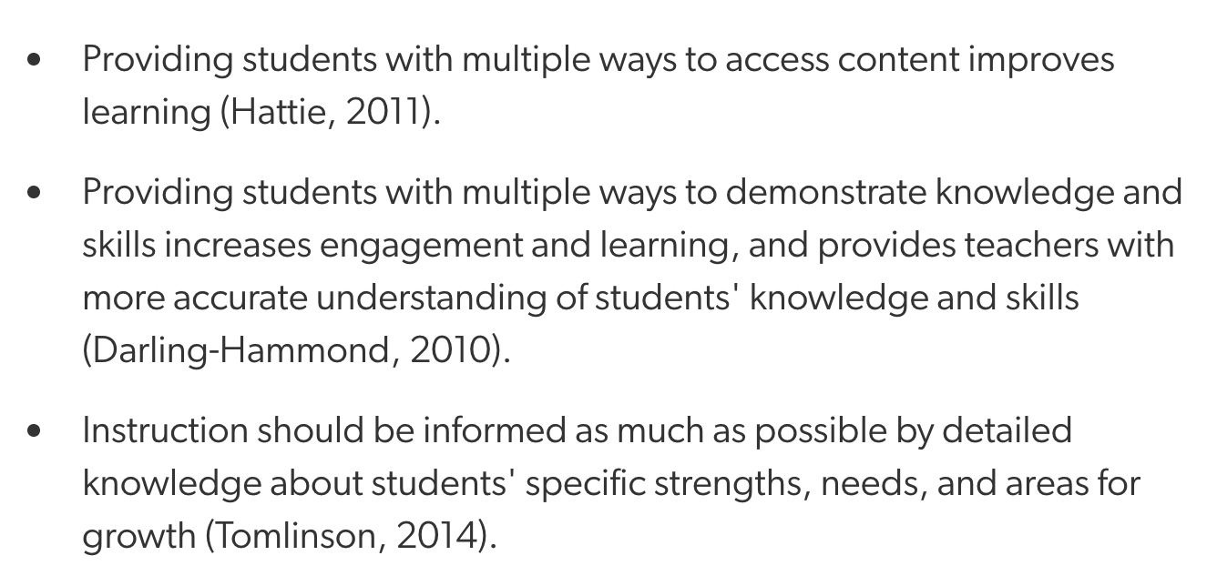
The Foundation (2): Consider Varied Approaches
from https://www.edutopia.org/multiple-intelligences-research
Notes:
https://www.edutopia.org/multiple-intelligences-research

Slide 4
The Foundation (2): Consider Varied Approaches
How can we approach writing instruction such that all students are afforded their best opportunity to succeed?
9 Types of Intelligence - Infographic by Mark Vital
https://blog.adioma.com/9-types-of-intelligence-infographic/
Notes:
https://blog.adioma.com/9-types-of-intelligence-infographic/

Slide 5
The Foundation (2): Consider Varied Approaches
Interestingly, I find that much of the writing process involves little to no actual writing—which can be very good news for those who struggle with writing, per se.
So here’s a challenge for you as a teacher:
To what extent are you able to teach writing without having your students actually write?

Slide 6
Idea: Storytelling Games
Story, Story
Group of 5(ish) in a circle with 1 in the middle
moderator (in the middle) determines kind
of story, then points to someone in the circle
to begin story
without notice, moderator points to someone
new, who must continue story
Alternate Version: Story, Story, Die
Moderator is the king/queen
If you falter, or displease the monarch, you
are killed
Fortunately/Unfortunately
partner game, one takes each role
(switch roles so each gets a turn)
One-Word Story
group of 4(ish)
must tell a story with each person, in turn, saying 1 word
Who can create a complete story, with a beginning, middle and an end
Excuses: see next slide

Slide 7
Excuses
Partners
Teacher assigns a bad situation that students need to talk themselves out of
Examples:
your homework isn’t done
you’re babysitting and your parents come home to find your
younger sibling locked in a closet
you just totaled your parents’ car
all of the the (freshly baked) cookies are gone
you’re late for school for the 29th time this month
1 student takes the role of the guilty party, who must explain him/herself, avoiding
responsibility at all costs.
The other student takes the role of authority figure, interjecting as often as necessary
to ensure that the task is as difficult as possible for the accused.
Repeat, switching roles each time

Slide 8
Fortunately/Unfortunately
partner game, one takes each role
(switch roles so each gets a turn)
One-Word Story
group of 4(ish)
must tell a story with each person, in turn, saying 1 word
Who can create a complete story, with a beginning, middle and an end
Story, Story
Group of 5(ish) in a circle with 1 in the middle
moderator (in the middle) determines kind
of story, then points to someone in the circle
to begin story
(etc.)
Excuses: see next slide

Slide 9
Let’s Talk About Drama
Poll
Which statement best describes your experience with drama in your classroom?
I have little or no experience using drama in my classroom.
I’ve used it here and there.
It’s something that happens fairly often in my classroom.

Slide 10
Idea:
Students act out a simple story, then write down what they acted out.
example on next slide

Slide 11
Sample Simple Story
A Meeting
Basic Requirements:
random groups of 3 1-2 minutes long no violence
Scene:
2 (or more) parties meet. (New kid at school? Job interview?
Secret meeting? Blind date?)
of course, there must be a problem (something goes wrong, or a conflict)
problem grows 2 or 3 times
problem resolved

Slide 12
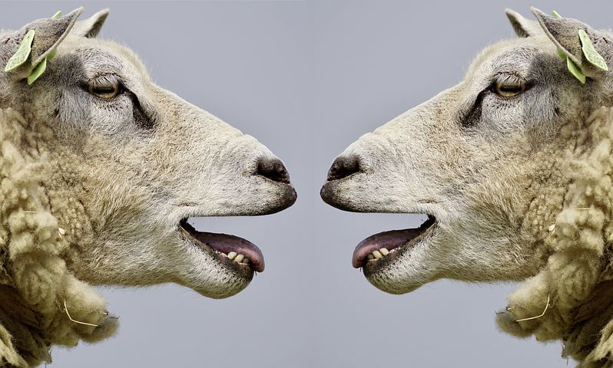
Let’s Talk!
Poll
We’ve talked about storytelling games & using drama to inspire story writing.
How do you feel about implementing some of this in your classroom?
Stoked. It’s happening Monday (or soon thereafter)!
I’ll try some of it, but I have reservations about certain aspects.
I have more reservations than a 5-star hotel!

Slide 13
Turn & Talk
Poll
We’ve talked about storytelling games & using drama to inspire story writing.
How do you feel about implementing some of this in your classroom?
What might work especially well in your classroom?
What obstacles would you anticipate? Solutions?
*Please share anything that’s worked well for you in the past!

Slide 14
Another Idea: What Could Go Wrong?
Brainstorm simple, everyday situations. Then ask, “What could go wrong?”
Reinforces Inciting Incident and “Raising the Stakes”
Classic example: Mr. Bean
(see next slide)

Slide 15
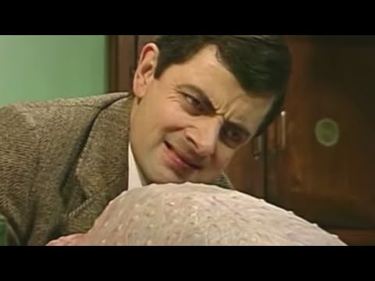
Another Idea: What Could Go Wrong?

Slide 16
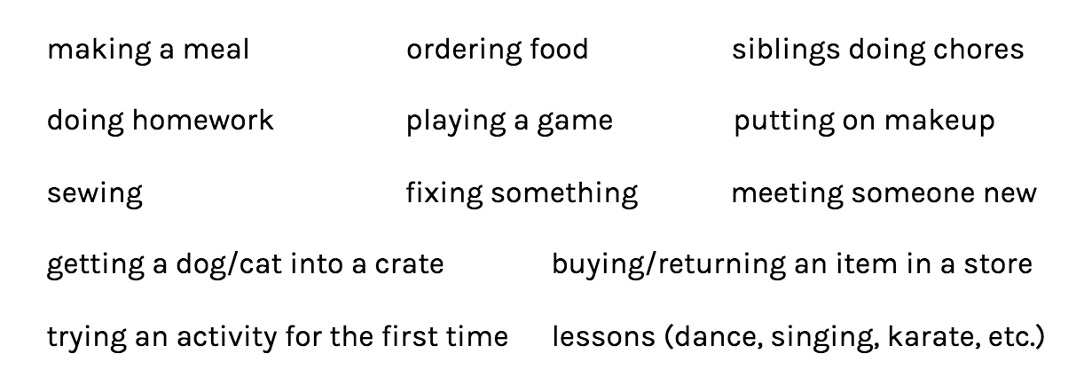
Sample “Simple Everyday Situations”
Keep it Simple!
Making a meal Ordering food
Putting on make-up X isn’t working
Getting dog/cat into crate First date/blind date
First time at the gym Siblings doing chore(s)
Buying/returning item at a store Sewing a button on
Trying an activity for 1st time Playing a game
Once a problem has been established, raise the stakes 2 or 3 times, then resolve.

Slide 17
Taking it further . . .
They’ll want to write ‘big stories’, like the ones they read in books.
Things like:
Defusing a bomb
Solving a crime
Finding a treasure
Falling in love
Same basic principles (sort of): something goes wrong, raise the stakes, resolve the problem

Slide 18
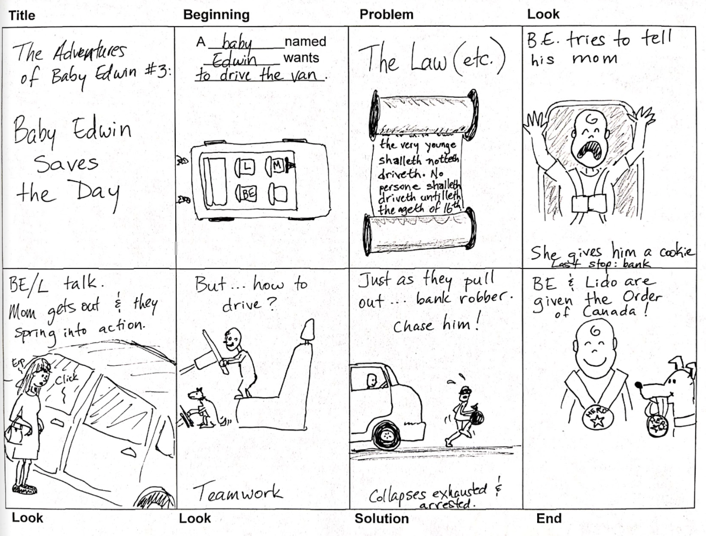
Related Idea: Box Story
Notes:
https://robinpawlak.com/teacher-resources/

Slide 19
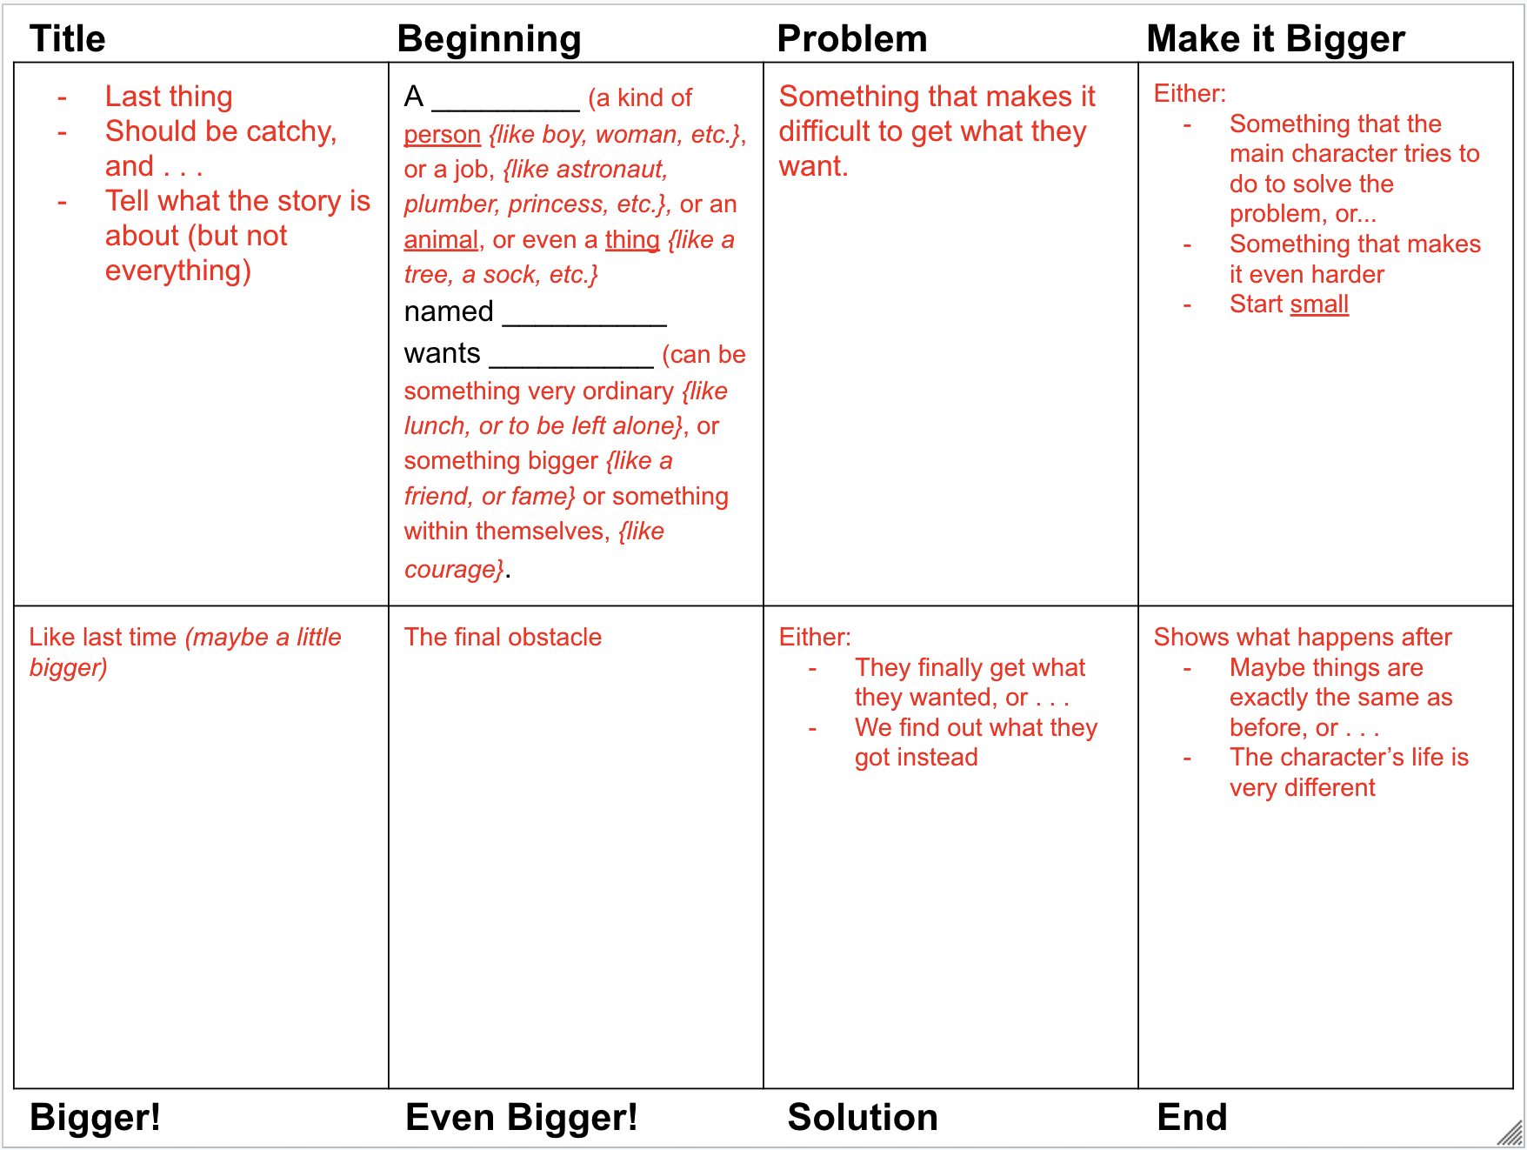
Related Idea: Box Story
Note:
Available on my website
Notes:
https://www.robinpawlak.com/wp-content/uploads/2021/02/Box-Story_-Details_Blank.pdf

Slide 20
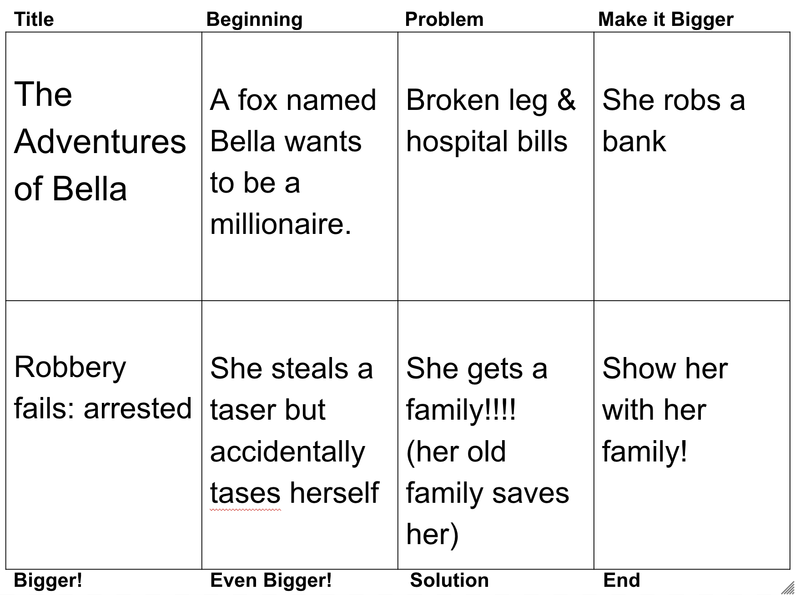
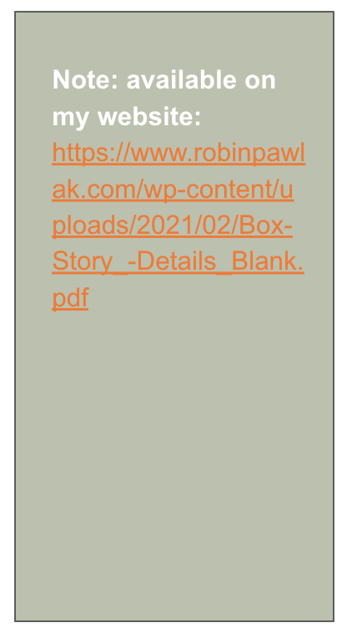
Related Idea: Box Story
Notes:
https://robinpawlak.com/teacher-resources/

Slide 21
Yet Another Idea: Random Story
Students create a story based on 3 random things.
There’s a description on my website. From there, you can navigate to a story I wrote using this technique.
Notes:
http://bit.ly/2ErvY4p

Slide 22
Another One: Characters and Settings
Students brainstorm:
A list of types of characters for a potential story (criminal, doctor, student, professor, etc. . . . There’s also a list you can download from my website.)
A list of interesting characteristics for potential story characters (short-tempered, clumsy, shy, etc . . . . There’s also a list you can download from my website.
A list of possible settings for a story (hospital emergency room, grocery store checkout, an elevator, etc.)
Using the 3 lists generated, students create 2 characters and place them in one of the settings, then write the story that might ensue.
Notes:
https://robinpawlak.com/wp-content/uploads/2023/05/Creating-Characters.pdf

Slide 23
Bonus Idea: The End.
Give your students the last line of a story and have them write the story that precedes it.
Example:
“Finally, upon reaching the top of the mountain, I raised the tuba to my lips and gave a mighty blast.”
What if your stuffed animals lived in another world?
Have you ever lost track of the fact that you’re just playing?
What do you own that might not like the way you treat it?

Slide 24
Super-Duper Bonus Idea!
Musical Stories
Each student gets a laptop and 3 minutes to begin writing a story.
After 3 minutes, all students must STOP (even if they’re in the middle of a sentence) and move to the next chair.
They have 3(ish) minutes to read and add to the story in front of them.
Repeat.
When you get near the end, let them know. (“Start wrapping up your story. This is the second last turn.”)
At the end, students return to their original chair and read (and react!).

Slide 25
What Haven’t We Talked About?
Questions?
Ideas to share?
Resources we should know about?
Things we haven’t covered?

Slide 26
Thanks!
Connect with me at
robinpawlak.com
Or on socials
Resources Writing Workshops Author Visits Stories & Writing Tips for Kids Space Cadets
Notes:
https://robinpawlak.com/

