Slide 1
CONTENT-
AREA WRITING
WRITING TO LEARN; LEARNING TO WRITE
Slides (and free resources for teaching writing) at robinpawlak.com > Teacher Resources
Notes:
https://www.robinpawlak.com/

Slide 2
CONTENT-AREA WRITING
Why?
Philosophy
Practical Ideas
Teaching writing is hard. Teaching content
is hard. But both? At the same time?
Come on.
Writing to learn and
learning to write
We’ll share!

Slide 3
CONTENT-AREA WRITING
Writing to Learn
“Like speaking and listening, writing isn’t ‘one more thing to teach’, but rather a tool to help students learn whatever it is you’re teaching.”
— Barbara R. Blackburn, PhD & TeachThought Staff
Learning to Write
Stay tuned for upcoming
pithy, inspirational
quote in this space.

Slide 4
CONTENT-AREA WRITING
Writing to Learn
—Youki Terada (edutopia)

Slide 5
WRITING TO LEARN
Basics
Some super-fun recreational reading for your “spare time”!
Typically…
Informal
Single draft
Ungraded (maybe formative)
For the student
Organizes thoughts, generates thinking, sparks recall, solidifies learning

Slide 6
WRITING TO LEARN
Ideas
Some super-fun recreational reading for your “spare time”!
Quick Writes/Writing Breaks (etc.)
Usually just a few minutes long
“If you were teaching fractions to a peer, what would be the most important things to mention?”
Your thoughts on: “Kids our age should be allowed to vote.”
“How would you explain photosynthesis to a 7-year-old?”
“You have X minutes. Jot down everything you know about the respiratory system.”
“What comes to mind when you think of imperialism?”
Can be used later for review

Slide 7
WRITING TO LEARN
Some super-fun recreational reading for your “spare time”!
Includes “20 Suggestions for Incorporating Writing in Other Subject areas”
Research, examples, ideas
https://www.teachthought.com/literacy/suggestions-ideas-for-writing-in-other-subject-areas/
https://www.edutopia.org/article/why-students-should-write-all-subjects
Quick writes, collaborative writing, informational writing, writing supports
Summary of learning to write/writing to learn
https://ellstudents.com/blogs/the-confianza-way/integrating-writing-into-all-content-areas
https://study.com/academy/lesson/teaching-strategies-for-content-area-writing.html
Notes:
https://www.teachthought.com/literacy/writing-other-subjects/
https://www.edutopia.org/article/why-students-should-write-all-subjects
https://ellstudents.com/blogs/the-confianza-way/integrating-writing-into-all-content-areas
https://study.com/academy/lesson/teaching-strategies-for-content-area-writing.html

Slide 8
CONTENT-AREA WRITING
Writing to Learn
“Like speaking and listening, writing isn’t ‘one more thing to teach’, but rather a tool to help students learn whatever it is you’re teaching.”
— Barbara R. Blackburn, PhD & TeachThought Staff
Learning to Write
Stay tuned for upcoming
pithy, inspirational
quote in this space.

Slide 9
CONTENT-AREA WRITING
Writing to Learn
“Like speaking and listening, writing isn’t ‘one more thing to teach’, but rather a tool to help students learn whatever it is you’re teaching.”
— Barbara R. Blackburn, PhD & TeachThought Staff
Learning to Write
“Writing is hard.”
— Robin Pawlak

Slide 10
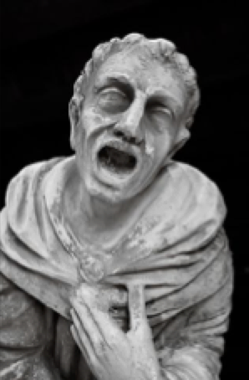
CONTENT-AREA WRITING
Required for a simple written response . . .
listening/reading/viewing (etc.) to know what’s
expected recall what do I want to say?
how do I say it? format physically creating
the letters and words spelling spacing capitalization punctuation grammar sentence structure paragraph structure organizing thoughts

Slide 11
CONTENT-AREA WRITING
Writing is not a particular thing,
or any single skill. In fact, the writing
process involves many, many steps and requires virtually innumerable skills.
Writing instruction that fails to take this
into account invariably leads to untold frustration for student and teacher alike.
— also Robin Pawlak (the guy just never shuts up)

Slide 12
CONTENT-AREA WRITING
Why?
Philosophy
Practical Ideas
Teaching writing is hard. Teaching content
is hard. But both? At the same time?
Come on.
Writing to learn and
learning to write
We’ll share!

Slide 13
CONTENT-AREA WRITING
MUST HAVES!
ENGAGEMENT
&
SUCCESS

Slide 14
SHARING PRACTICAL IDEAS
CHALLENGES
POTENTIAL SOLUTIONS
“I’m not an
LA teacher!”
I don’t have the background.
I don’t have the time.

Slide 15
SHARING PRACTICAL IDEAS
CHALLENGES
POTENTIAL SOLUTIONS
Collaborate with LA teachers!
They
have
ideas.
“I’m not an
ELA teacher!”
I don’t have the background.
They have
expertise.
They have
dedicated class time.

Slide 16
SHARING PRACTICAL IDEAS
CHALLENGES
POTENTIAL SOLUTIONS
Resources
“I’m not an
ELA teacher!”
I don’t have the background.
Please
share!
Writing 101.
Jennifer Serravallo
Regie Routman
Notes:
https://www.jenniferserravallo.com/

Slide 17
SHARING PRACTICAL IDEAS
CHALLENGES
POTENTIAL SOLUTIONS
“Students in my content-area classes struggle with even the simplest writing tasks.”
Sumtimes. Not eve in cumpleat centinsis Dosn’t make cents

Slide 18
SHARING PRACTICAL IDEAS
CHALLENGES
POTENTIAL SOLUTIONS
“Students in my content-area classes struggle with even the simplest writing tasks.”
Sumtimes. Not eve in cumpleat centinsis Dosn’t make cents
Hmmmm…?

Slide 19
SHARING PRACTICAL IDEAS
CHALLENGES
POTENTIAL SOLUTIONS
Writing 101: Break it Down
“I’m not an
ELA teacher!”
As much as possible, teach and assess
one thing at a time.
I don’t have the background.

Slide 20
CONTENT-AREA WRITING
Required for a simple written response . . .
listening/reading/viewing (etc.) to know what’s
expected recall what do I want to say?
how do I say it? format physically creating
the letters and words spelling spacing capitalization punctuation grammar sentence structure paragraph structure organizing thoughts

Slide 21
SHARING PRACTICAL IDEAS
CHALLENGES
POTENTIAL SOLUTIONS
Writing 101: Break it Down
“I’m not an
ELA teacher!”
Requires analysis of every writing task:
I don’t have the background.
Exactly what type of written response are you looking for?
What’s the simplest possible version of that?
What skills will they need to accomplish the task?

Slide 22
EXAMPLES: BREAK IT DOWN
Complete sentence(s)?
With or without explanation/reasons?
Key words?
Phrases?
Jot notes? Point form? List?
Essay?
Report?
Paragraph?

Slide 23
EXAMPLES: BREAK IT DOWN
Sentence frames*
Use same/similar form consistently
“I’m not an
ELA teacher!”
Sentence stems*
chart
template
Talk to primary teachers!
*Examples/explanation of stems/frames
Notes:
https://bit.ly/3Gy0rd6

Slide 24
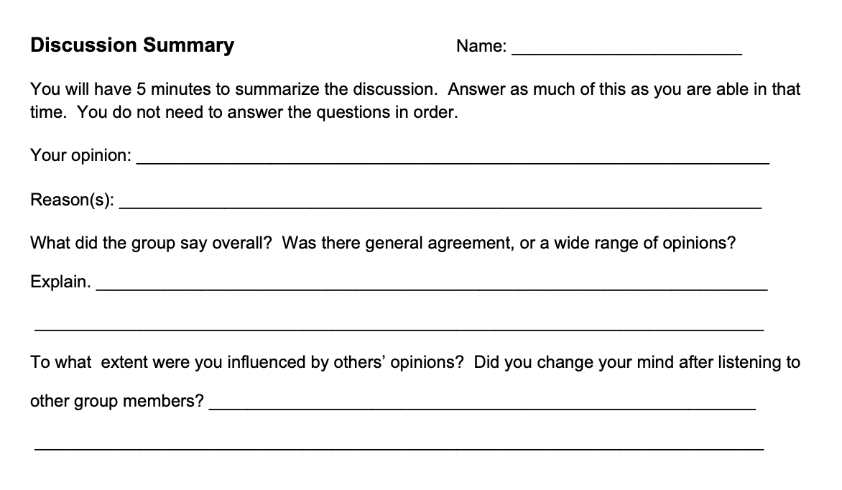
EXAMPLES: BREAK IT DOWN
“I’m not an
ELA teacher!”

Slide 25
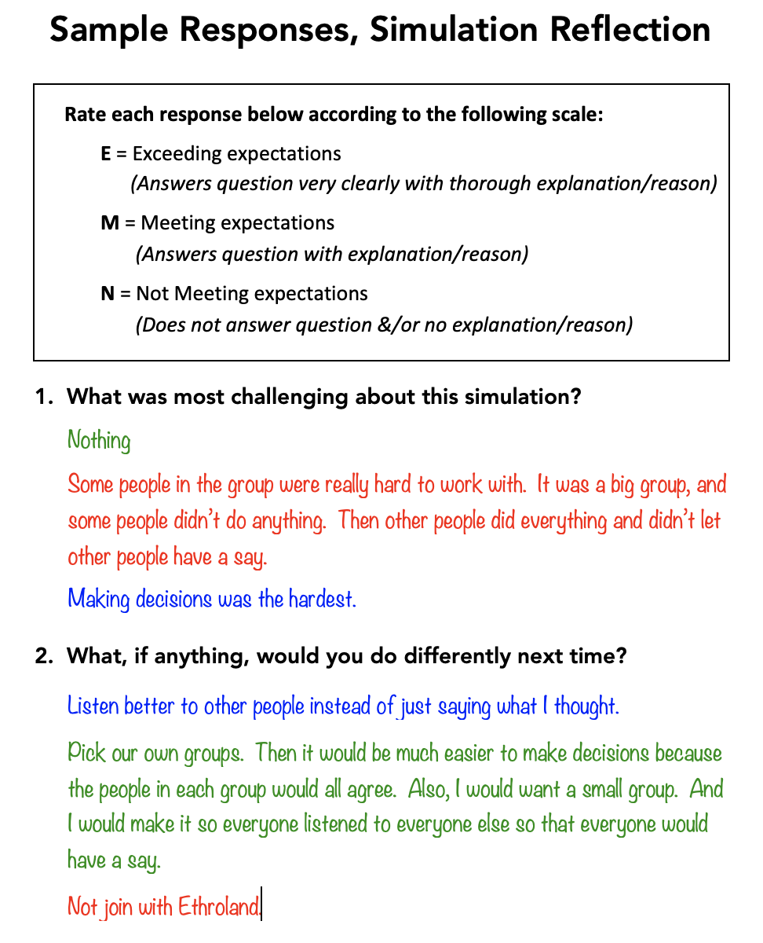
EXAMPLES: BREAK IT DOWN
“I’m not an
ELA teacher!”

Slide 26
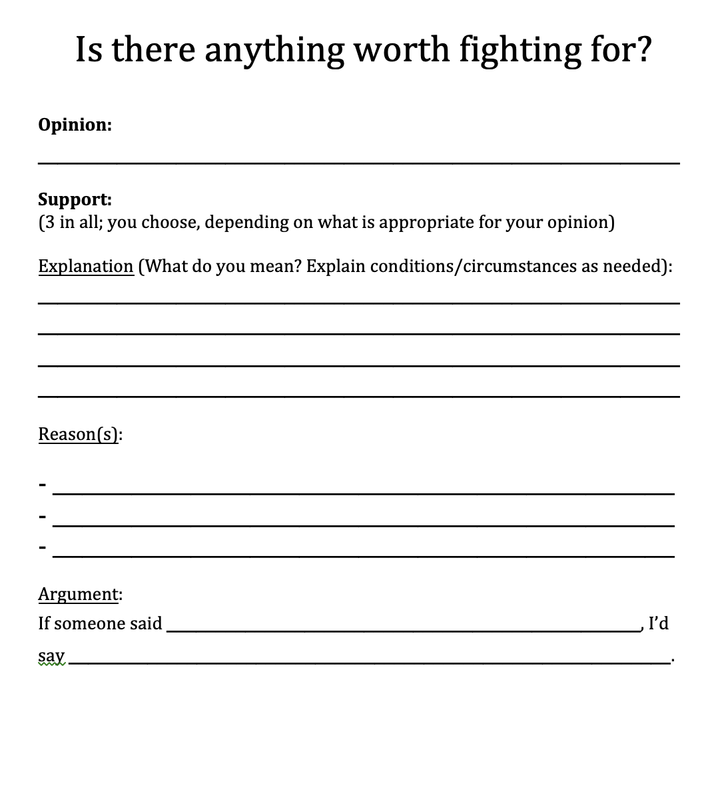
EXAMPLES: BREAK IT DOWN
“I’m not an
ELA teacher!”

Slide 27
EXAMPLES: BREAK IT DOWN
“I’m not an
ELA teacher!”

Slide 28
SHARING PRACTICAL IDEAS
CHALLENGES
POTENTIAL SOLUTIONS
Writing 101: Show them success.
(modelling)
What would a good response look like?
Positive & negative examples?
I don’t have the background.
Sources:
Your Writing
Student Writing
Media
Books

Slide 29
SHARING PRACTICAL IDEAS
CHALLENGES
POTENTIAL SOLUTIONS
“What about engagement?”
Writing can kill an otherwise engaging content-area lesson.

Slide 30
SHARING PRACTICAL IDEAS
CHALLENGES
POTENTIAL SOLUTIONS
Creative solutions!
“I’m not an
ELA teacher!”
I don’t have the background.

Slide 31
SHARING PRACTICAL IDEAS
CHALLENGES
POTENTIAL SOLUTIONS
Creative solutions!
“I’m not an
ELA teacher!”
What am I trying to accomplish?
I don’t have the background.
Might there be a more interesting way to get there?

Slide 32
SHARING PRACTICAL IDEAS
Creative solutions!
CHALLENGES
POTENTIAL SOLUTIONS
“I’m not an
ELA teacher!”
What am I trying to accomplish?
Teaching?
If so…
Assessment?
Of what?
I don’t have the background.
Content-area knowledge?
Content-area skills?
Writing skills?
Something else?

Slide 33
SHARING PRACTICAL IDEAS
Creative solutions!
CHALLENGES
POTENTIAL SOLUTIONS
Might there be a more
interesting
way to get there?
“I’m not an
ELA teacher!”
I don’t have the background.
Is writing even
necessary?

Slide 34
SHARING PRACTICAL IDEAS
Creative solutions!
CHALLENGES
POTENTIAL SOLUTIONS
Alternatives to Writing
“I’m not an
ELA teacher!”
drawings
think/pair/share
interviews
I don’t have the background.
songs
Act out X
PE-type games
diagrams
X in a minute
court cases
spark thinking & recall enable students to visualize demonstration of learning

Slide 35
SHARING PRACTICAL IDEAS
Creative solutions!
CHALLENGES
POTENTIAL SOLUTIONS
More Engaging Writing
“I’m not an
ELA teacher!”
news stories
social media posts
I don’t have the background.
Correspondence between:
scientists
historical figures
heart and lungs
numbers
etc.

Slide 36
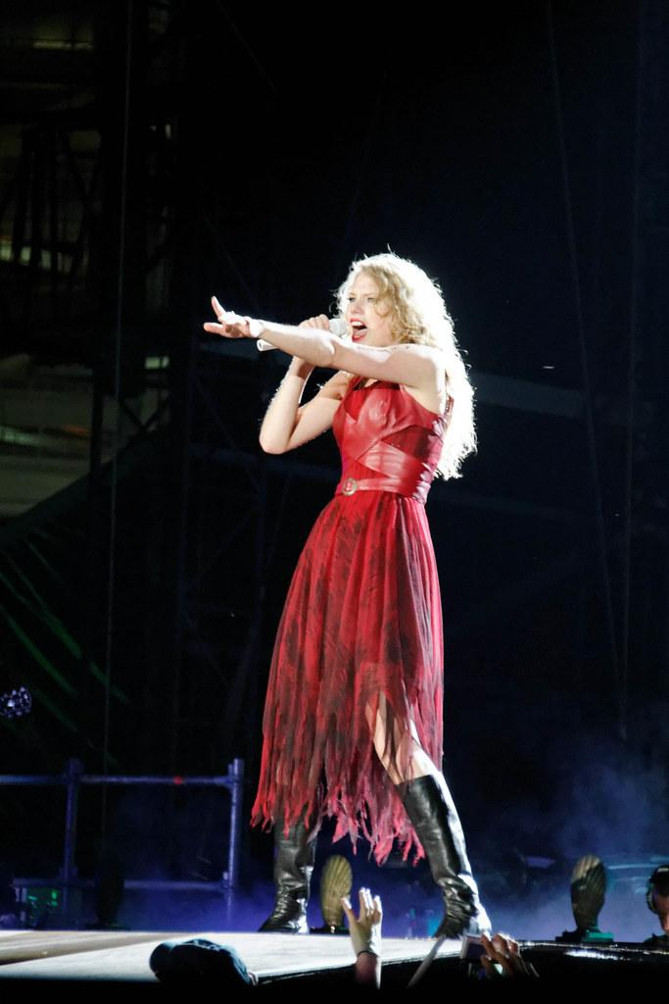
Did we miss anything?
Speak now!
Thoughts? Questions? Ideas to share?

Slide 37
Thanks!
Connect with me at robinpawlak.com
OR . . .
Notes:
https://www.robinpawlak.com/

