Slide 1
3 Simple Tricks That Make Editing
Fun and Easy!*
* . . . and other lies.
Disclaimer: The presenter notes that terms such as “fun” and “easy” are relative, and given that they refer to human emotions, highly subjective. Therefore, it must be stated that those engaged in “editing”, whether using techniques discussed in this session or otherwise, may or may not have a positive experience. As such, the presenter absolves himself of responsibility for any trauma experienced in such pursuits, whether by participants or their students, and shall not be held liable. Your participation in this session indicates that you have read this disclaimer and have courageously chosen to remain, so as to continue your noble pursuit of excellence in this highly challenging aspect of English language education.
You’ll find these slides (and lots of resources for teaching writing) at
robinpawlak.com > Teacher Resources

Slide 2
3 Simple Tricks That Make Editing
Fun and Easy!*
* . . . and other lies.
You’ll find these slides
(and lots of resources for teaching writing) at
robinpawlak.com > Teacher Resources

Slide 3
OUTLINE
Editing is Hard
Realistic Expectations
(for students and their teachers)
Best Practices*
* The presenter notes that terms such as “best” are relative, and that educators are humans rather than robots so that what works well for one may, given variability in individual teaching styles and strengths, prove ineffective for another, and let’s be honest, when you hear someone advocating a particular “best practice” that they employ so very deftly, do you not, just a little bit, wonder whether they don’t possibly think they’re just a little bit “best-er” than you?
Editing is hard

Slide 4
OUTLINE
Editing is Hard
Realistic Expectations
(for students and their teachers)
Best Practices*
* Sorry. Nothing to see here.
Editing is hard

Slide 5
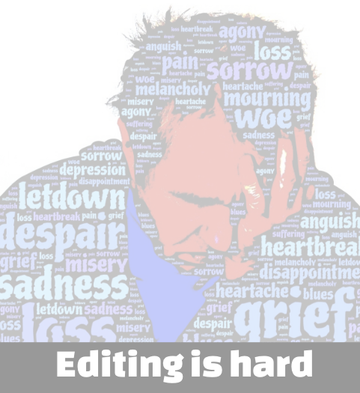
Poll: Your Students’ Editing Skills
Editing skills? What editing skills?
There’s a wide range, but overall, not great.
Meh.
There’s a wide range, but overall, pretty good.
They’re rocking it! I don't even know why I’m here, honestly.
Which statement best describes your students' collective editing skills?
(Pick 1.)

Slide 6
Poll: Teaching Editing
I don’t want to talk about it.
I’m a good teacher, but this is a relative weak spot for me.
Meh.
Pretty solid, but I could use a few more tools.
I’m rocking it! I don't even know why I’m here, honestly.
Which statement best describes how you feel about your teaching in this area?
(Pick 1.)

Slide 7
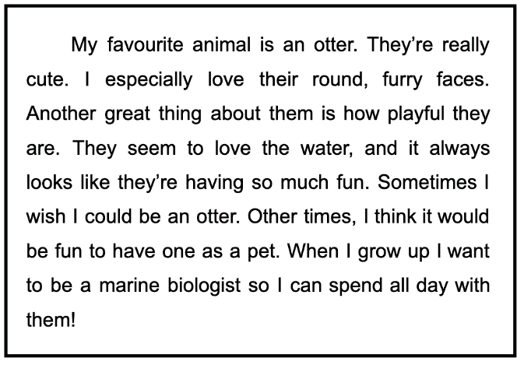
Sample
Paragraph
How many mistakes might a child make in writing this paragraph?

Slide 8
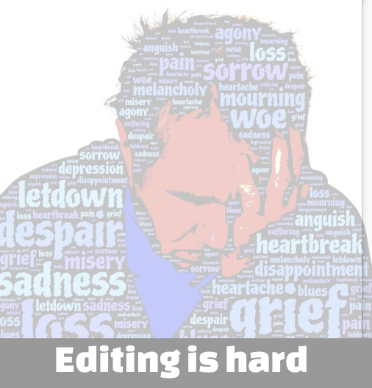
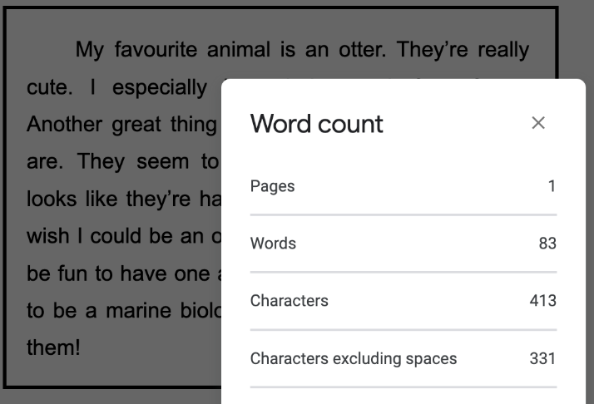
Sample
Paragraph
How many mistakes might a child make in writing this paragraph?

Slide 9
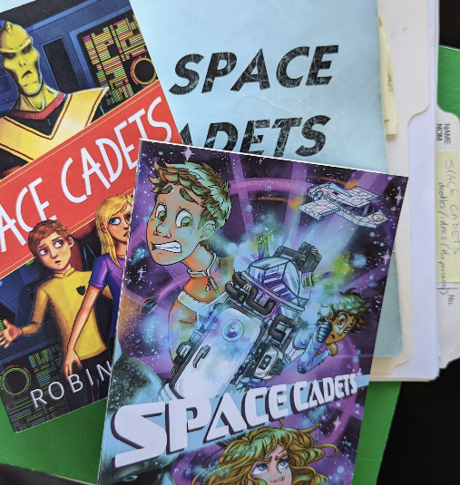
My
Editing Journey
Editing is hard !

Slide 10
Types of Editing
Developmental/Structural (etc.) Editing
- big picture: plot development/structure, characters, themes, pacing, POV, tense, dialogue, plot holes, order, flow, etc.
Copy Editing
- mechanical; grammar, punctuation, spelling, etc.
Line/Stylistic Editing
- sometimes considered copy editing, sometimes separate
- stylistic; looks at manuscript line by line and considers word choice (incl. elimination of adjectives/adverbs in favour of strong verbs, & elimination of cliches/jargon/euphemisms), trimming/tightening prose, sentence/paragraph structure etc.
Proofreading
- usually last, looking for mistakes that may have slipped through, considers every comma, space, page number (and other formatting), etc.

Slide 11
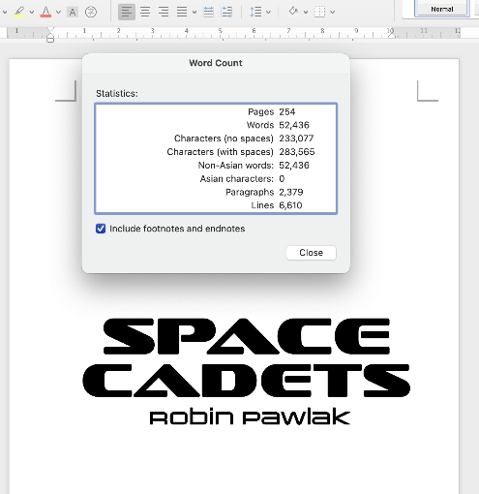
My
Editing Journey
Editing is hard !

Slide 12
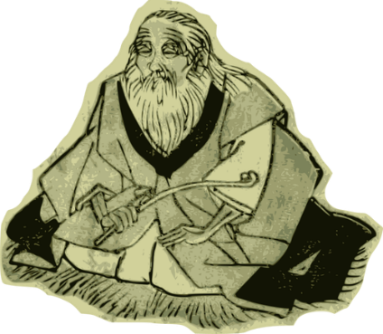
Everyone
struggles with editing.
Perfection is virtually
unattainable. Learning
is the ultimate goal.

Slide 13
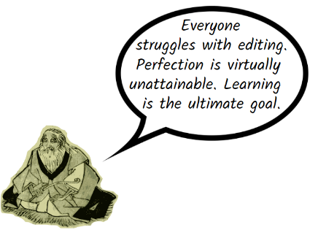
To what extent do you
agree with this statement?
If true, how does this . . .
impact the pressure (& anxiety level) for students (& teachers)?
reframe what success looks like as it pertains to writing & editing?
impact teaching & assessment?
If it’s not true . . .
What would be a more accurate statement?
How does this impact teaching & assessment?

Slide 14
OUTLINE
Editing is Hard
Realistic Expectations
(for students and their teachers)
Best Practices
YOU ARE HERE
How often should I expect students to edit? What kind(s) of editing should I teach? What does student success look like? How often should I be giving them feedback in this area? If the answer is what I think it is, is that even possible? What about my mental health? Did I choose the right profession? What will I do the next time someone says, “Teachers have it easy. It must be nice to have all those holidays!” Would I be better off in prison anyway? Where does one learn how to make a shiv? Should this be part of my PD plan? Why are my thoughts always so dark?

Slide 15
The Never-Ending Dance of the Teacher
Realistic Expectations
Best
Practices

Slide 16
Robin’s 5 Commandments
Thou shalt resist thine inner perfectionist
Thou shalt teach and assess only one thing at a time.
Thy students shalt not edit their writing the same day they writeth it.
When it comes to editing, thou shalt not beat it to death.
Thou shalt resist thine inner perfectionist
for Teaching Editing

Slide 17
Robin’s 5 Commandments
Thou shalt resist thine inner perfectionist
Thou shalt teach and assess only one thing at a time.
Thy students shalt not edit their writing the same day they writeth it.
When it comes to editing, thou shalt not beat it to death.
Thou shalt resist thine inner perfectionist
for Teaching Editing

Slide 18
Robin’s 5 Commandments
Thou shalt resist thine inner perfectionist
Thou shalt teach and assess only one thing at a time.
Thy students shalt not edit their writing the same day they writeth it.
When it comes to editing, thou shalt not beat it to death.
Thou shalt resist thine inner perfectionist
for Teaching Editing

Slide 19
Types of Editing
Developmental/Structural (etc.) Editing
- big picture: plot development/structure, characters, themes, pacing, POV, tense, dialogue, plot holes, order, flow, etc.
Copy Editing
- mechanical; grammar, punctuation, spelling, etc.
Line/Stylistic Editing
- sometimes considered copy editing, sometimes separate
- stylistic; looks at manuscript line by line and considers word choice (incl. elimination of adjectives/adverbs in favour of strong verbs, & elimination of cliches/jargon/euphemisms), trimming/tightening prose, sentence/paragraph structure etc.
Proofreading
- usually last, looking for mistakes that may have slipped through, considers every comma, space, page number (and other formatting), etc.

Slide 20
Thou shalt teach and assess
only one thing at a time.
What do they know?
or
What are they
able to do?
02
What do they need
to learn next?
01
03
Teach
Repeat
05
04
Assess

Slide 21
Robin’s 5 Commandments
Thou shalt resist thine inner perfectionist
Thou shalt teach and assess only one thing at a time.
Thy students shalt not edit their writing the same day they writeth it.
When it comes to editing, thou shalt not beat it to death.
Thou shalt resist thine inner perfectionist
for Teaching Editing

Slide 22
Robin’s 5 Commandments
Thou shalt resist thine inner perfectionist
Thou shalt teach and assess only one thing at a time.
Thy students shalt not edit their writing the same day they writeth it.
When it comes to editing, thou shalt not beat it to death.
Thou shalt resist thine inner perfectionist
for Teaching Editing

Slide 23
Robin’s 5 Commandments
Thou shalt resist thine inner perfectionist
Thou shalt teach and assess only one thing at a time.
Thy students shalt not edit their writing the same day they writeth it.
When it comes to editing, thou shalt not beat it to death.
Thou shalt resist thine inner perfectionis.
for Teaching Editing

Slide 24
Discussion
Questions?
Concerns?
Please share! What has/hasn’t worked for you in your classroom?
Possible Questions
for Discussion
How often should students edit?
How thoroughly should students edit?
What about feedback?

Slide 25
What about
Peer Editing?
Aren’t you guys
so glad our
teacher taught us to peer edit?
Must be
taught!

Slide 26
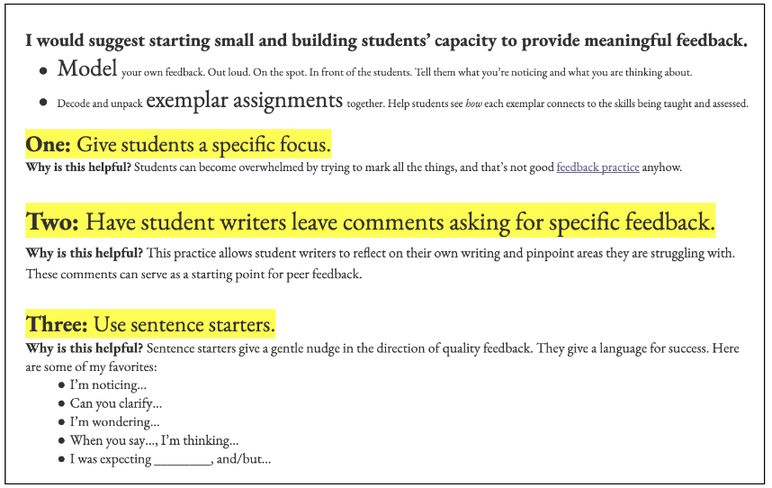
What about
Peer Editing?
A great resource:
Peer Editing Smackdown from Lindsay Ann Learning
https://www.education.com/lesson-plan/three-step-peer-editing/

Slide 27
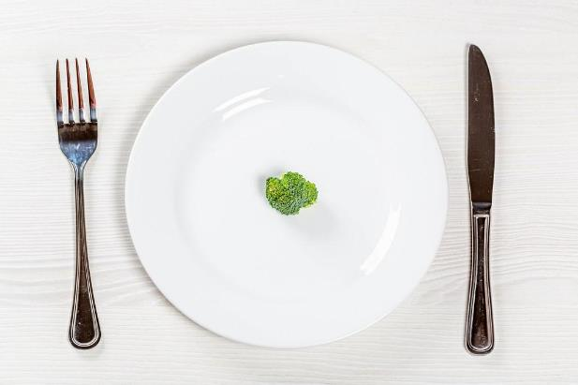
How often
should my students edit?
Mini?
Many!
Limit
big edits.

Slide 28
Resources
Title/Author | Source | Overview
Teaching Writing or Editing Writing? | Edutopia by Susan Barber | Edutopia (a free source of information, inspiration, and practical strategies for learning and teaching in preK-12 education) | Ongoing Feedback, Freedom to Experiment, Self-Editing Skills, Strengthening Content and Ideas, Student Reflection
A Practical Strategy for Teaching Editing Skills - TCEA blog by Emily Hopkins | TCEA (a nonprofit association of educators working to advance learning with technology) | A GRR (gradual release of responsibility) approach with some excellent tips
Teaching Students to Edit Their Own Writing by Jamie Sears | Diary of a Not So Wimpy Teacher (website with resources & tips) | Mistakes Happen, Leave Room for Editing, Don’t Edit Too Soon, Editing Day, Give Resources, One Type of Edit at a Time, Read Writing Out Loud, Don’t Edit for Them, Perfection Isn’t the Goal
5 Tips for Teaching Students How To Revise and Edit Writing by Jen, Two Little Birds Teaching | Two Little Birds Teaching (website with resources & tips) | Revising vs. Editing, 5 Tips for Revising and Editing
How to Teach Editing and Revising - Lucky Little Learners by Mary Kate Bolinder | Lucky Little Learners (website with resources & tips) | Revising vs. Editing, resources, Acronyms: FARMS, CROPS,
30 Resources and Tips to Help Your Students Love Editing by Teach Starter | Teach Starter (website with resources & tips) | Look for the Great, Edit a Copy, Read it Aloud, Edit the Next Day, Peer Editing Helps Students Learn to Love Mistakes, Use Supporting Resources, Make it Fun!

Slide 29
Resources
Shared by Cheryl Miller, Holy Spirit Catholic School Division:
“I like that the big bad wolf comes back multiple times to notice more mistakes . . . I also like how each time he revisits the letter, he focuses on something new such as finger spaces, capitals, etc . . . . There are so many other things teachers could also point out such as dialogue, onomatopoeia, and many funny/descriptive examples of figurative language.”
https://www.amazon.com/Little-Red-Big-Bad-Editor/dp/153446929X

Slide 30
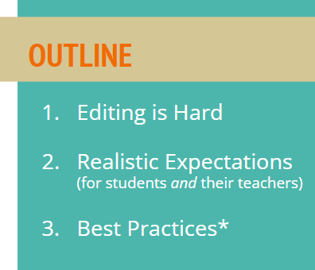
Did we miss anything?
Speak now!
Thoughts?
Questions?
Ideas to share?

Slide 31
Thanks!
Connect with me at robinpawlak.com
Or on socials
Resources Writing Workshops Author Visits Stories and Writing Tips for Kids Space Cadets

